Slide 1
Housing-Price Prediction Project

Slide 2
Exploratory Data Analysis

Slide 3
Steps
Importing the libraries needed for THE project
Loading the dataset/Creating NEW data frame
Checking the BASIC DETAILS of the dataset(first five rows)
Checking the shape of the dataset
Checking the datatypes
Checking for null values if any
These data analysis steps help us to get an overview of our dataset and also help us in pre-processing of our data.

Slide 4
DATA PRE_PROCESSING

Slide 5
STEPS TAKEN WHILE HANDLING THE DATA.
checked the shape and datatypes of the train dataset.
dropped some columns which are not efficient.
checked the value counts of the necessary columns and also checked if any null values are present.
used Label Encoder to encode the object type columns and used mean to replace the null values.
done some visualizations using heatmap,barplots,cat-plot and scatter-plots.
checked the correlation between dependant and independent variables using heatmap.
split the DATA FRAME: dependant and independent variables into x and y ESPECTIVELY.
used StandardScaler method TO CONVERT THE OBJECT DATA TYPE TO NUMERICAL SO THAT THE data GETS ready for model building.

Slide 6
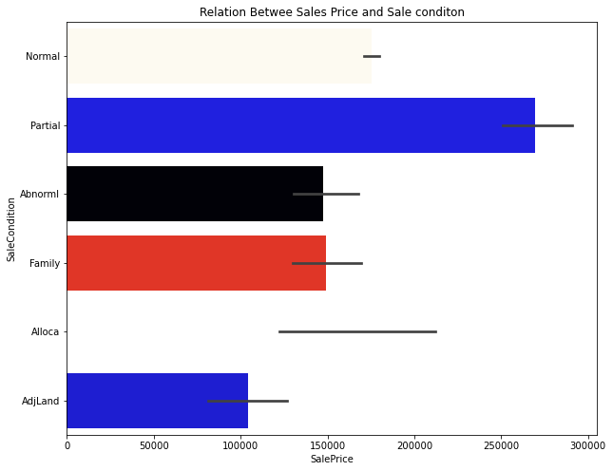
VISUALIZATION DONE DURING PREPROCESSING
Some visualization is done using bar-plots, cat-plot and scatter-plots.

Slide 7
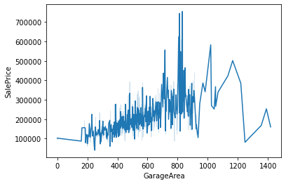
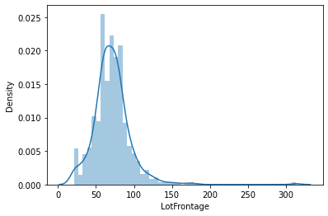
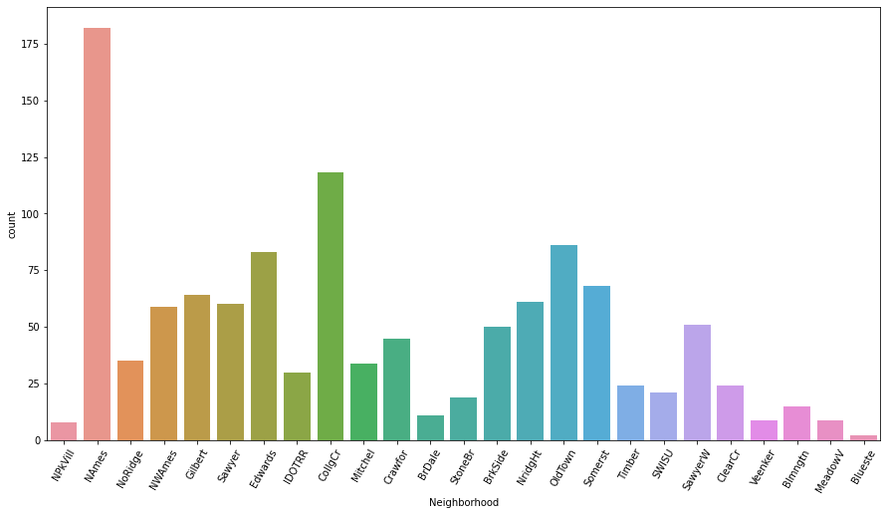

Slide 8
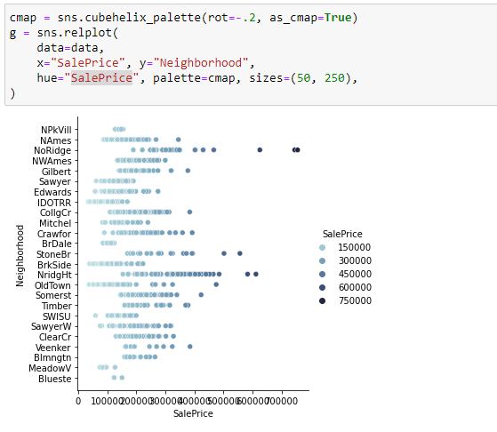

Slide 9
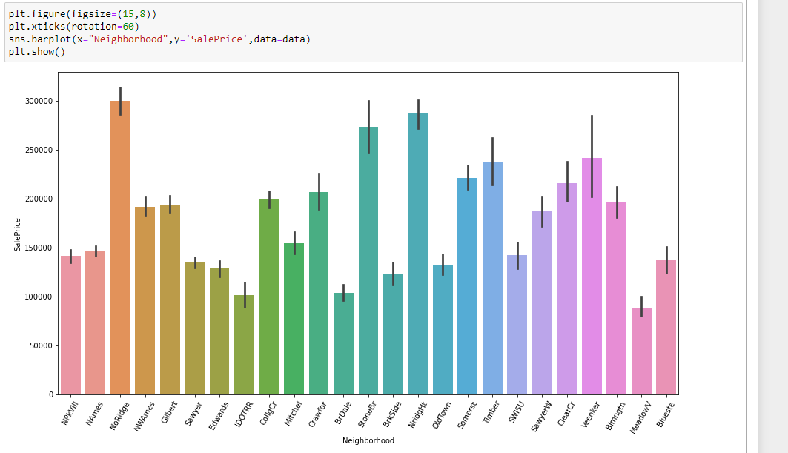

Slide 10
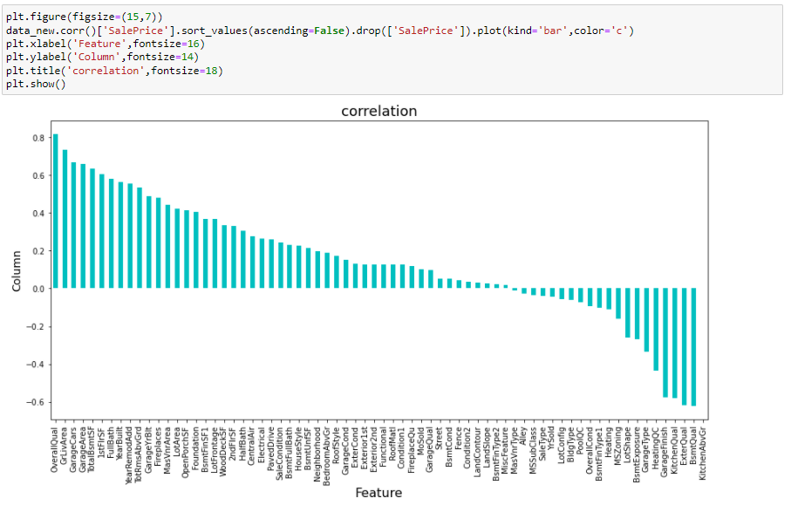

Slide 11
MODEL BUILDING

Slide 12
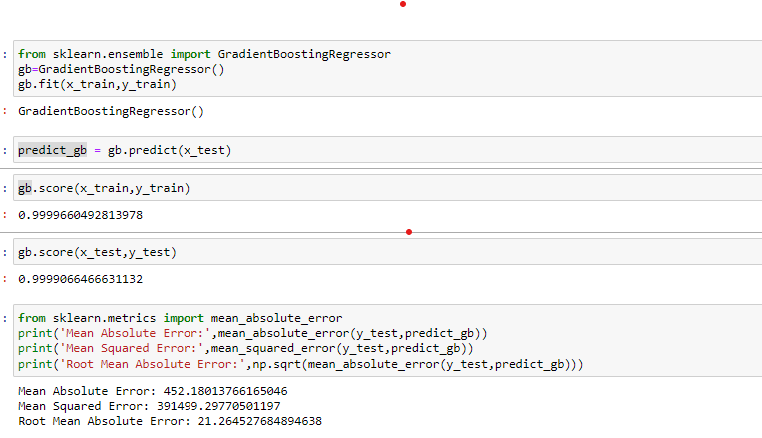
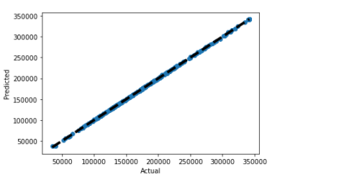
Explanation

Slide 13
TEST DATASET
Imported the CSV file and created a data frame for the test dataset and follow all the pre-processing steps like: checking for the null values and replacing them, some visualization steps, scaled the dataset using standard scaler.
Trained my model on my train dataset and predict on my test dataset.

